Slide 1

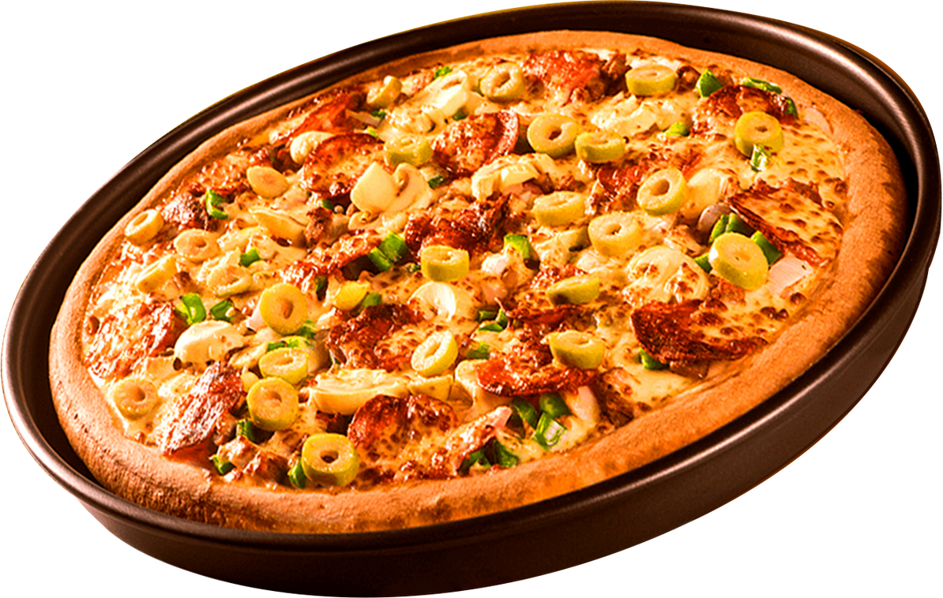


PIZZA SALES REPORT
USING SQL

Slide 2


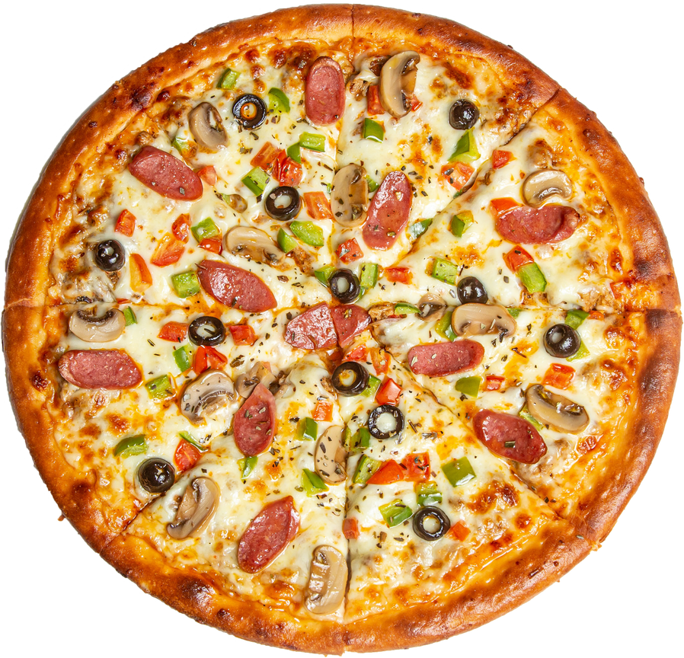
Home
About
REPORT IS ABOUT
This project involves analyzing a Pizza Sales dataset using SQL to uncover meaningful business insights.
The queries are organized into Basic, Intermediate, and Advanced levels, focusing on different aspects of data exploration and analysis.
Through this project, I enhanced my SQL skills and practiced applying them in a real-world business context, aiming to support data-driven decision-making.

Slide 3
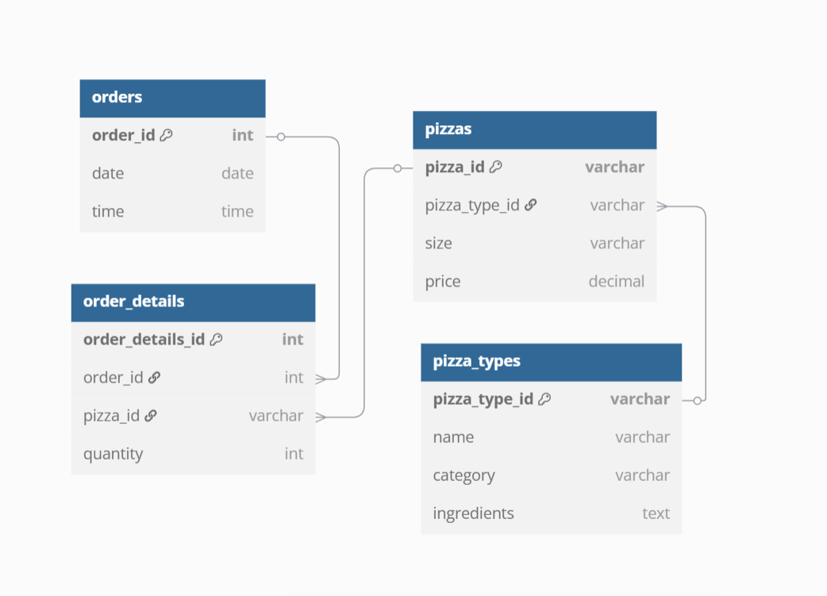
SCHEMA DIAGRAM
Home
About

Slide 4
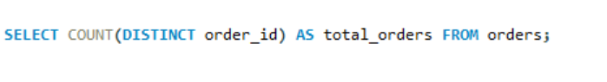
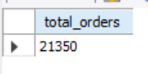
BASICS
1. RETRIEVE THE TOTAL NUMBER OF ORDERS PLACED

Slide 5
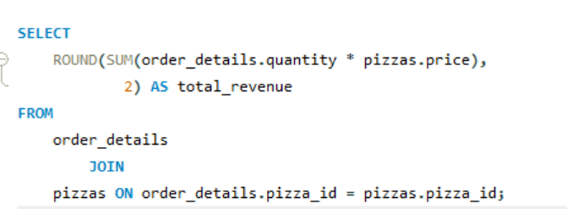
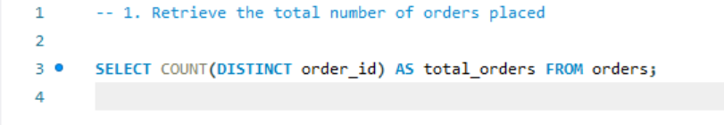
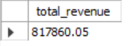
BASICS
2. CALCULATE TOTAL REVENUE GENERATED FROM PIZZA SALE

Slide 6
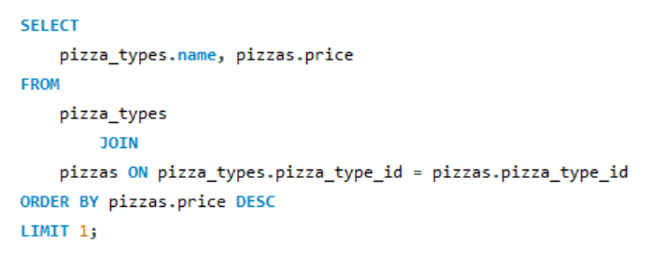
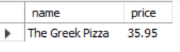
BASICS
3. IDENTIFY THE HIGHEST PRICED PIZZA?

Slide 7
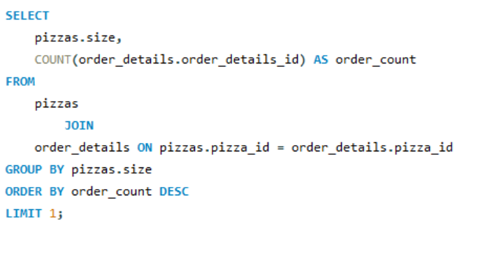
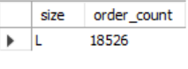
BASICS
4. IDENTIFY THE MOST COMMON PIZZA SIZE ORDERD?

Slide 8
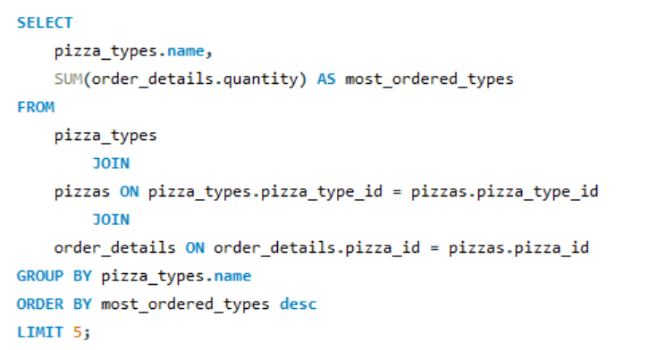
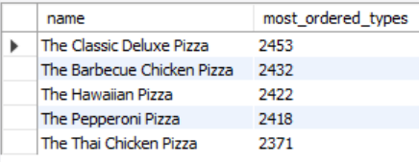
BASICS
5. LIST THE TOP 5 MOST ORDERED TYPES ALONG WITH THEIR QUANTITIES?

Slide 9
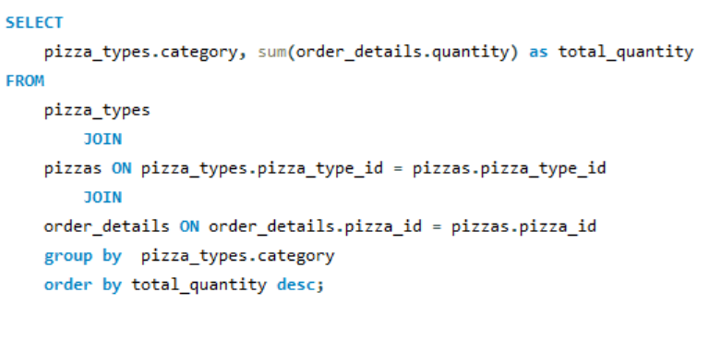
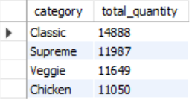
INTERMEDIATE
6. JOIN THE NECESSARY TABLES TO FIND THE TOTAL QUANTITY OF EACH PIZZA ORDERED

Slide 10
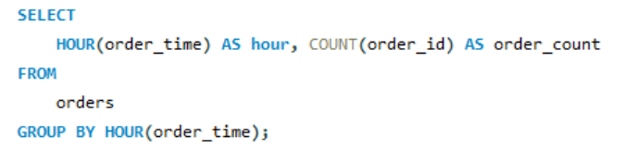
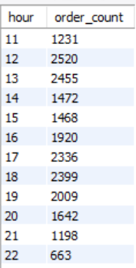
INTERMEDIATE
7. DETERMINE THE DISTRIBUTION OF ORDERS BY HOUR OF THE DAY.

Slide 11
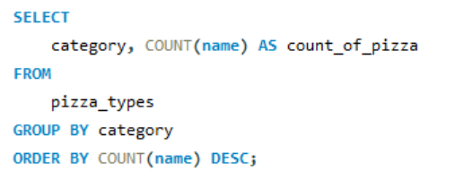
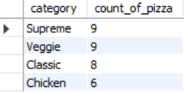
INTERMEDIATE
8. JOIN THE RELEVANT TABLES TO FIND THE CATEGORY WISE DISTRIBUTION OF PIZZAS.

Slide 12
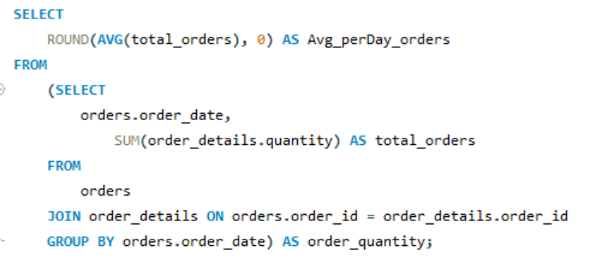
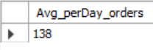
INTERMEDIATE
9. GROUP THE ORDERS BY DATE AND CALCULATE THE AVERAGE NUMBER OF PIZZAS ORDERED PER DAY.

Slide 13
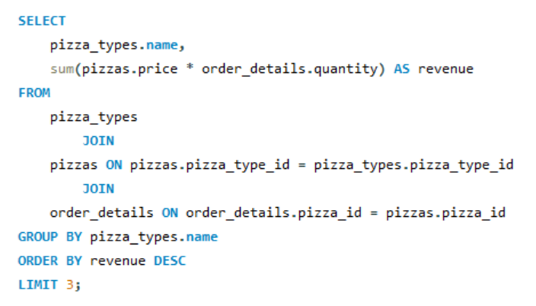
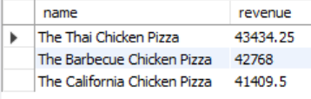
INTERMEDIATE
10. DETERMINE THE TOP 3 MOST ORDERED TYPES BASED ON REVENUE.

Slide 14
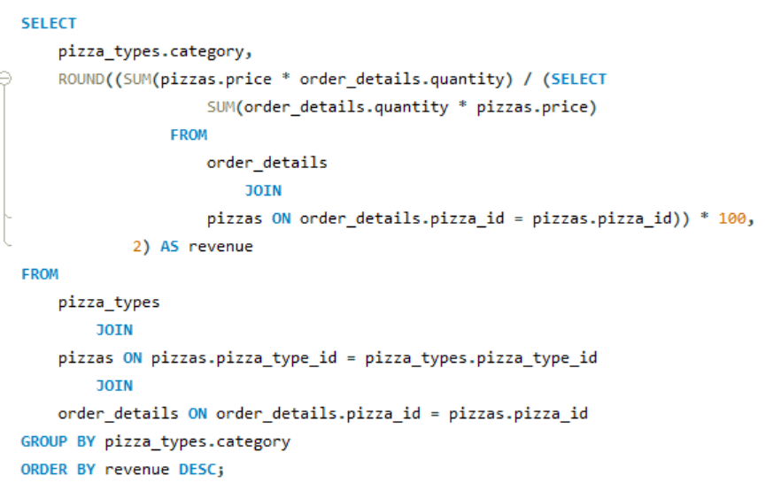
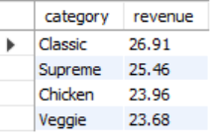
ADVANCED
11. CALCULATE THE PERCENTAGE CONTRIBUTION OF EACH PIZZA TYPE CATEGORY TO TOTAL REVENUE.

Slide 15
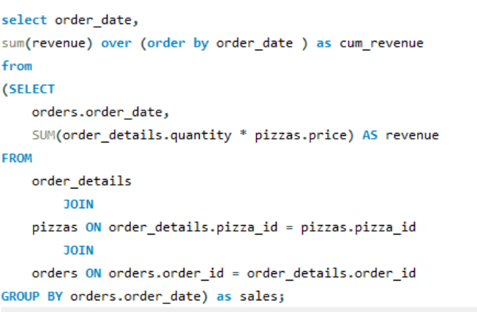
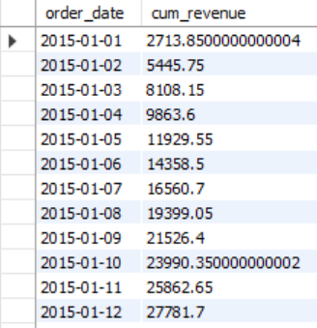
ADVANCED
12. ANALYZE THE CUMULATIVE REVENUE GENERATED OVER TIME

Slide 16
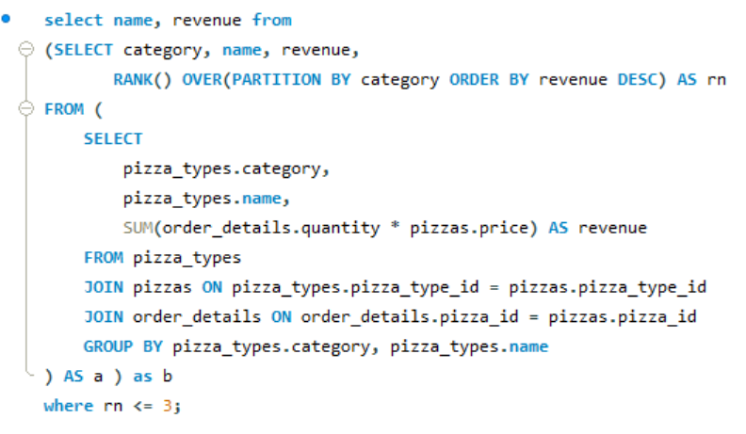
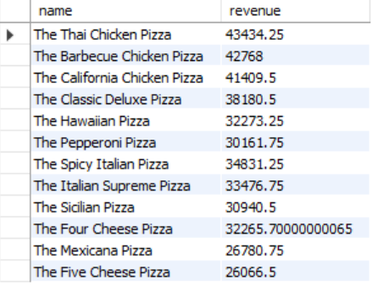
ADVANCED
13. DETERMINE THE MOST ORDERED PIZZA TYPES IN DECREASING ORDER BASED ON REVENUE FOR EACH PIZZA CATEGORY

Slide 17
THANK YOU
FOR ATTENTION
2025 PIZZA SALES REPORT

